Slide 1
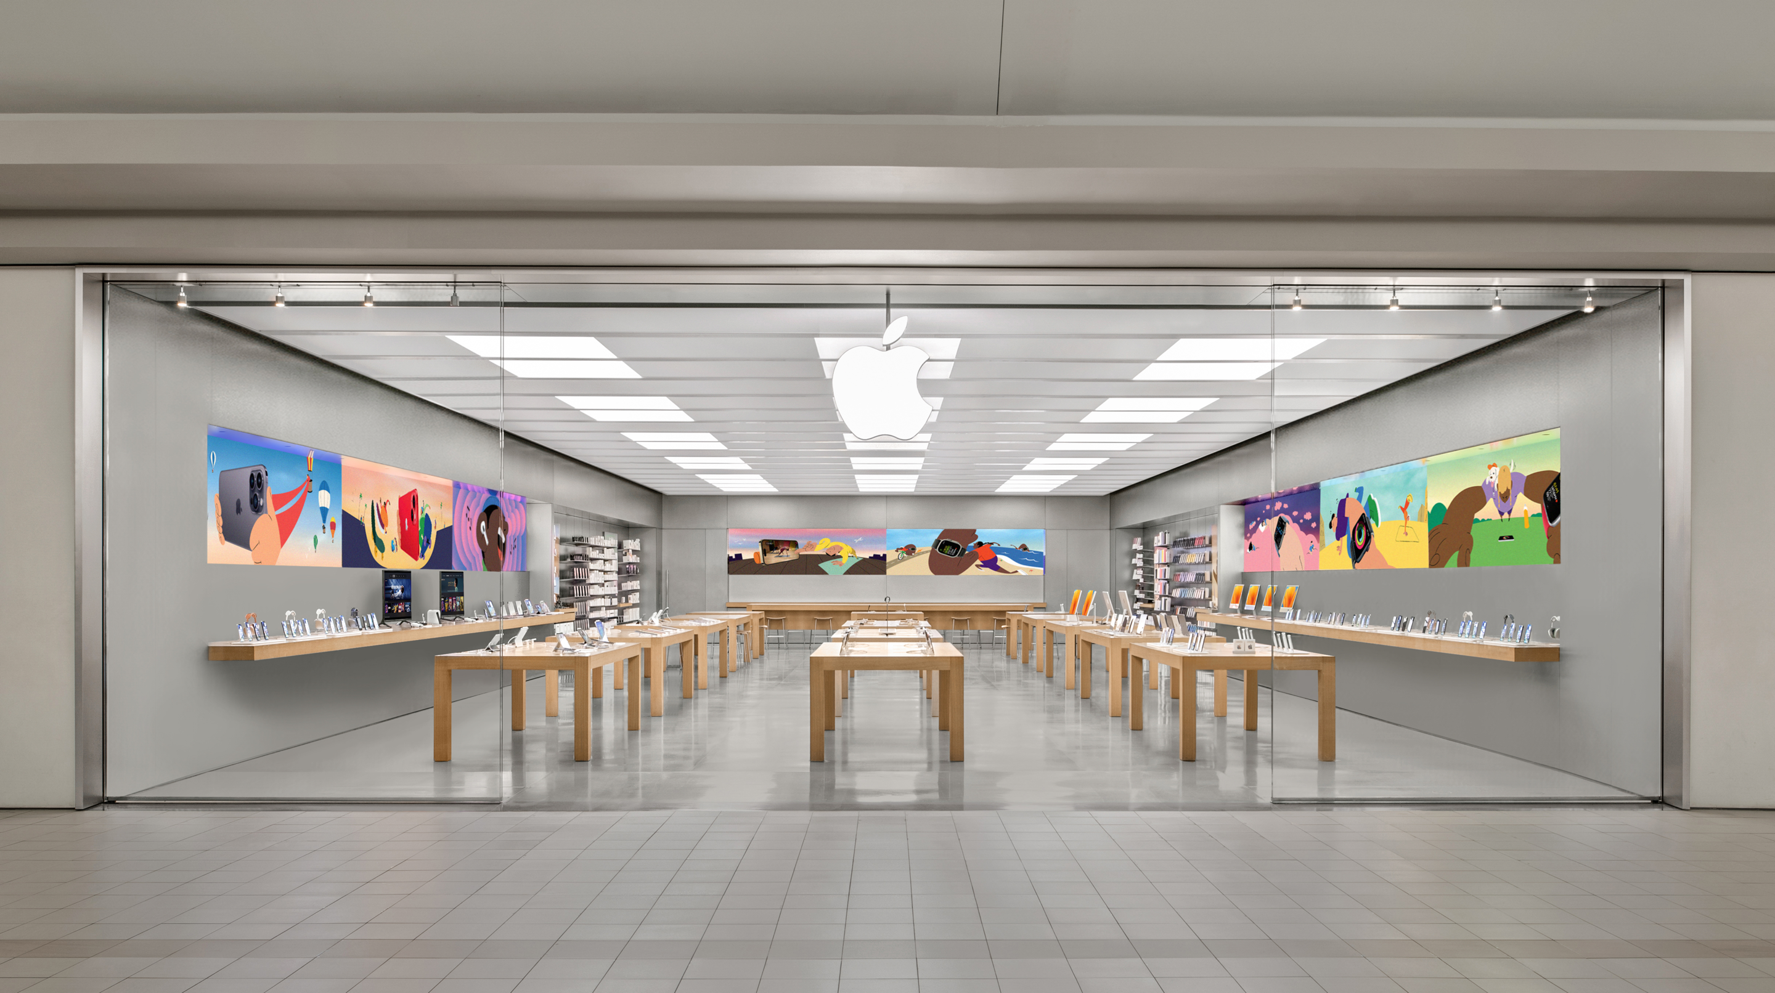
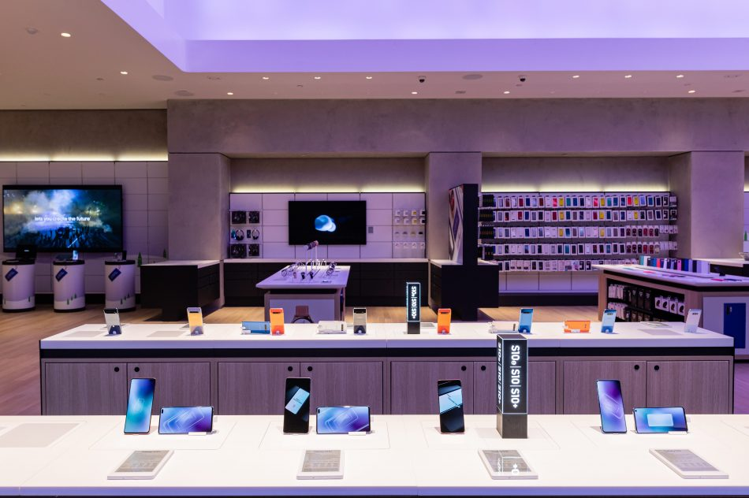
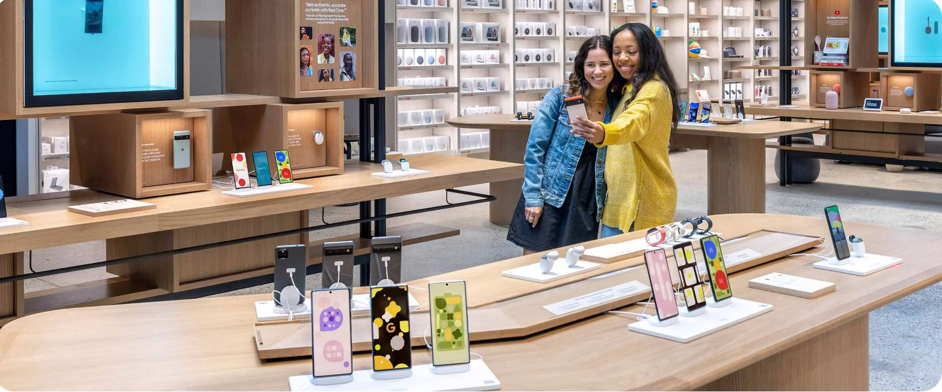
Feature Extraction and Price Prediction-Cell Phones
Title- Price Prediction with ML Models
Name-Debasis Panda
GitHub- https://github.com/Deb052024/Machine-Prediction.git

Slide 2
Feature Extraction and Model Building-Case Flow
Overview of Project and Data Exploration
Data Pre - Processing and Most Occurring Features Across Models
Highest Market Price Models Features Plot
Feature Importance and Selection
Supervised Machine Learning Model Building and Performance Based on KPI
Cross Validations
Recommendation

Slide 3
Overview of Project and Data Exploration
Project Scenario:
A prominent organization that specializes in selling mobile phones. The organization is keen to enhance its pricing strategy by gaining a deeper understanding of the key features that influence the prices of mobile phones in today's highly competitive market.
Objective is to build a predictive model that can accurately estimate the price of a mobile phone based on its features. To achieve this, will perform a feature extraction analysis to identify the most influential features.
Project Description:
In this project will work with a dataset that contains detailed information about various mobile phones, including their model, color, memory, RAM, battery capacity, rear camera specifications, front camera specifications, presence of AI lens, mobile height, processor, and, most importantly, the price.
Primary goal is to develop a predictive model for mobile phone prices.

Slide 4
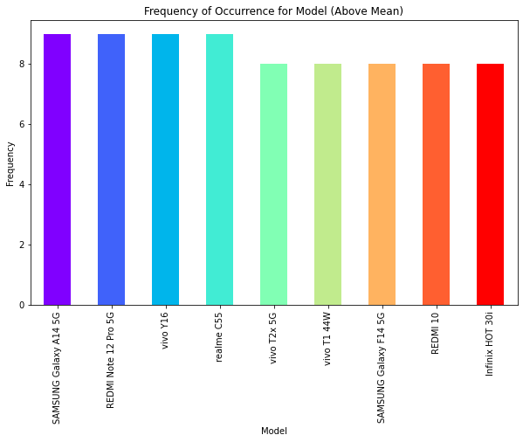
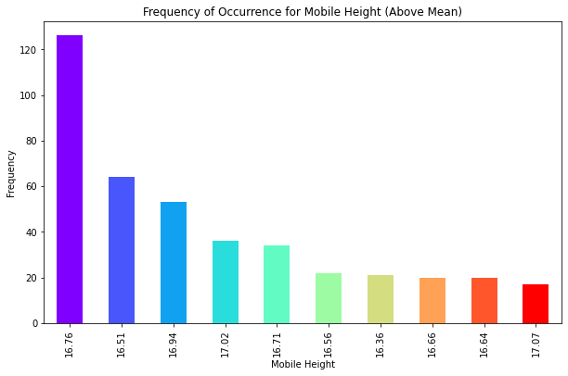
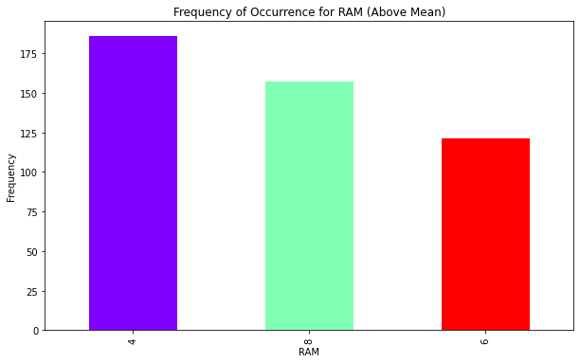
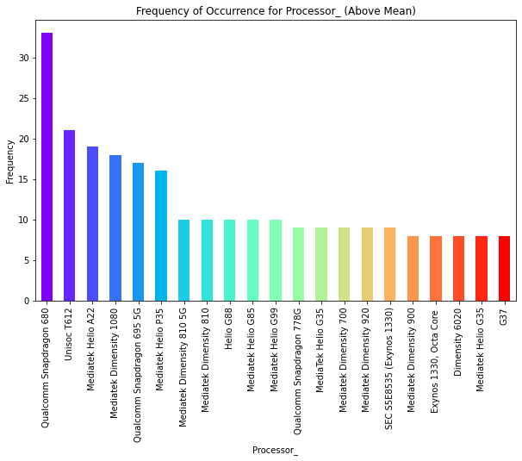
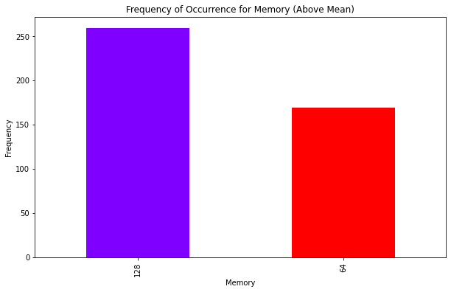
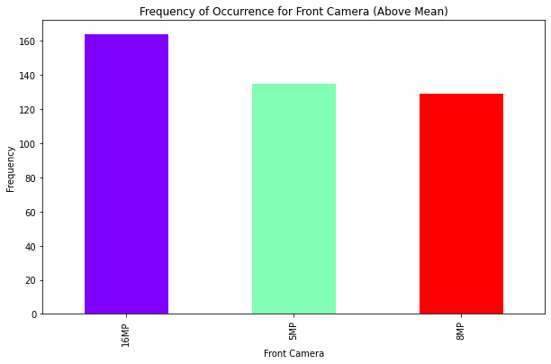
Most Occurring Features Across Models
16.76 inch height handset are having maximum presence in the distribution
SAMSUNG Galaxy A145G, VIVO Y16, realmeC55 have got maximum occurrences
Maximum cell phones with 126GB Memory, 4 GB RAM and 16MP Front camera
QualComm SnapDragon Processors are mostly used in cell Phones

Slide 5
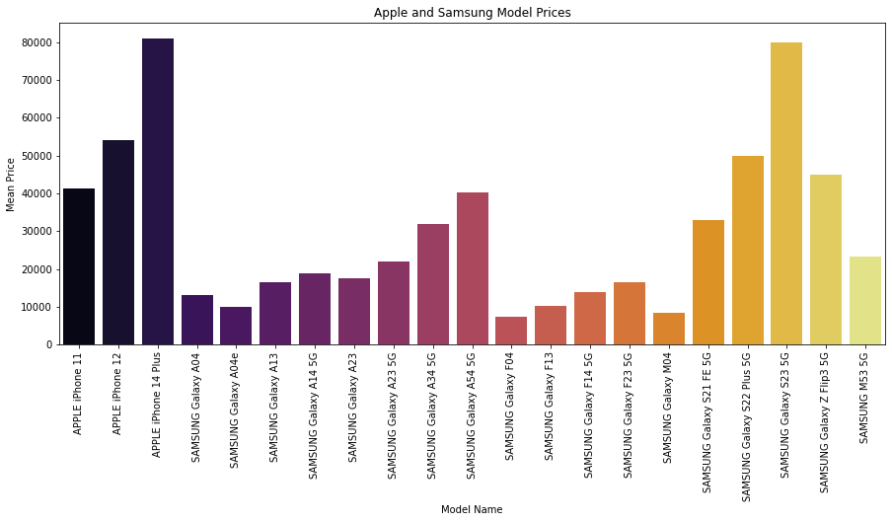
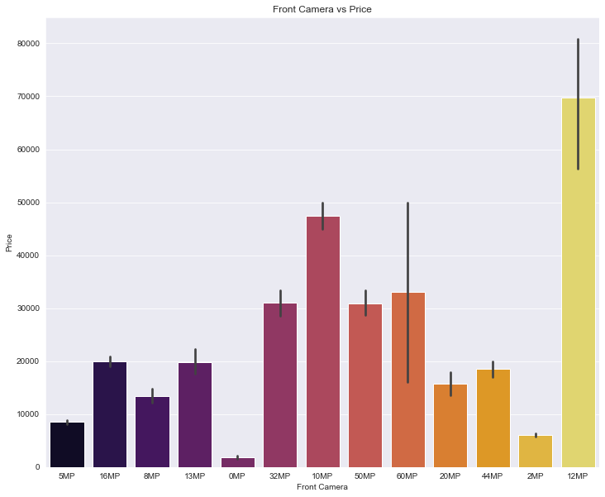
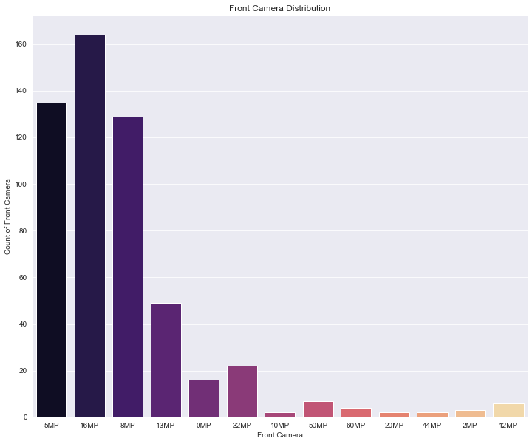
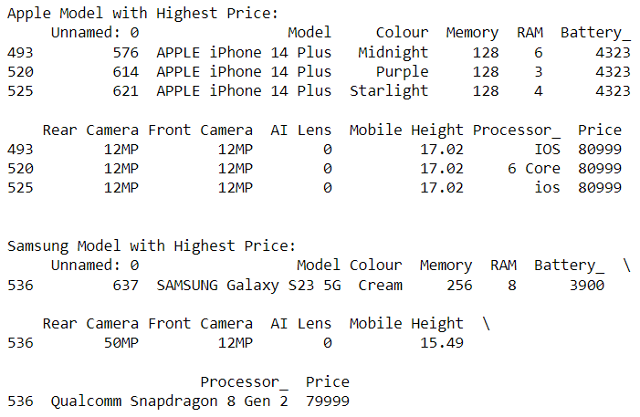
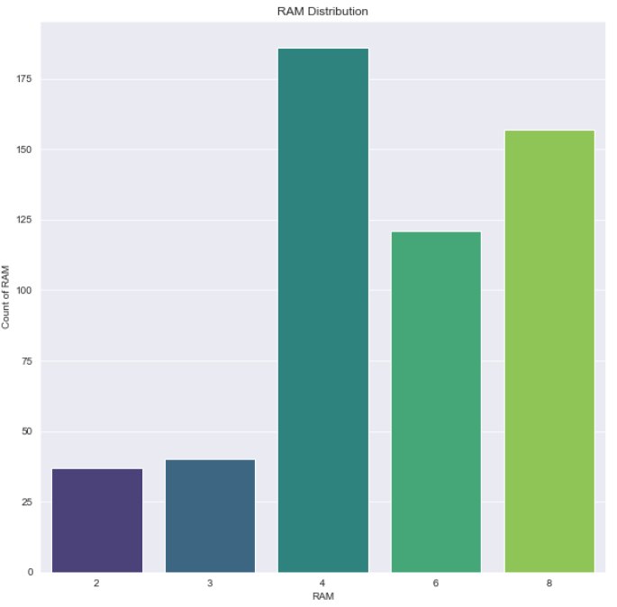
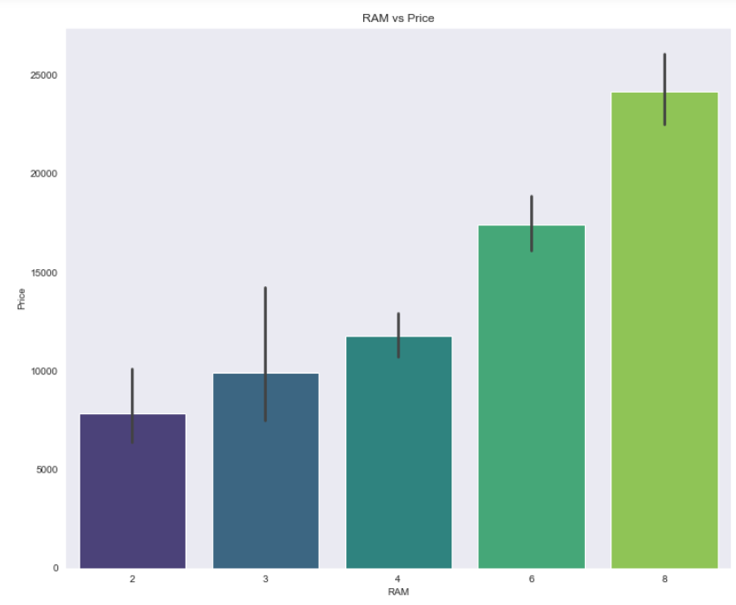
Highest Market Price Model -Features
Apple Phones are most costliest in market with equal front and Rear camera of 12 Mega Pixel
With 128GB Memory APPLE are the costliest with bigger heights compared to 256GB Memory of Samsung Cell Phones, Brand being the differentiator
12MegaPixel Front camera are costliest but most cameras present are of 10 or 8 Mega Pixel,
8GM RAM is the mostsought-after ever the current distribution is having most cell phones with 4GB RAM

Slide 6
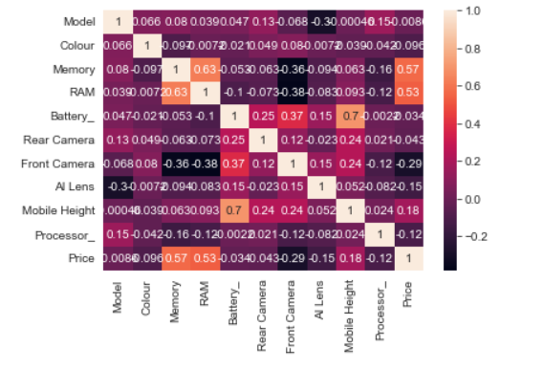
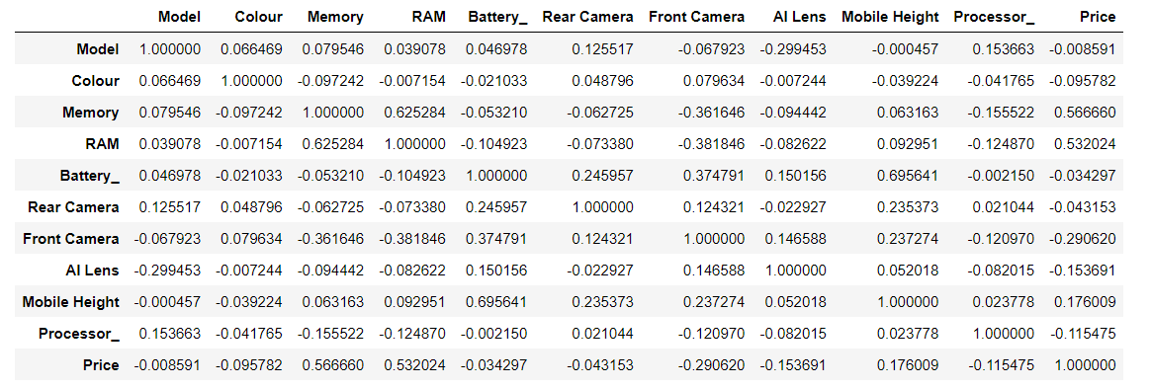
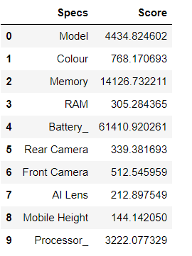
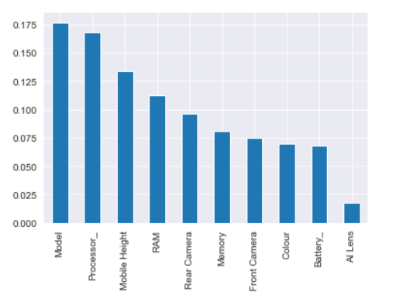
Feature Importance and Selection
Based on High Degree of positive correlation – Key Features related to price are –Memory, RAM, Mobile Height
Based on SelectKBest Method –Key Features are – Model, Battery, Memory, Processor
Based on ExtraTree Classifier Method –Key Features are – Model, Battery, Mobile Height ,Processor

Slide 7
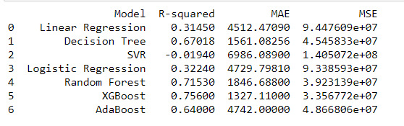
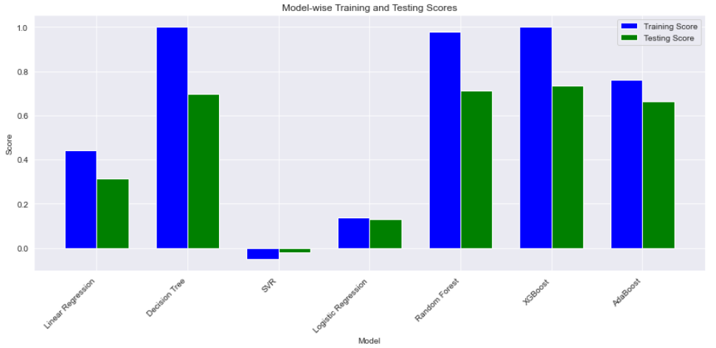
Supervised Regression Machine Learning Models and KPI
 | Scores
Model Name | Training Accuracy | Testing Accuracy
Linear Regression | 0.44 | 0.31
Decision Tree Regressor | 0.99 | 0.69
Support Vector Regressor | -0.05 | -0.019
Logistics Regression | 0.13 | 0.12
Random Forest Regressor | 0.97 | 0.71
XGB Regressor | 0.99 | 0.74
AdaBoost Regressor | 0.76 | 0.66
Logistics Regression Training and Testing score are least
XGBoost and Random Forest Regressor scores are highest and scond highest
R^2 , Mean Absolute Error and Mean Square values indicate XGBoost is the best predictor model for Price
Adjacent graph depicts ensemble techniques perform well compared to individual learner models

Slide 8
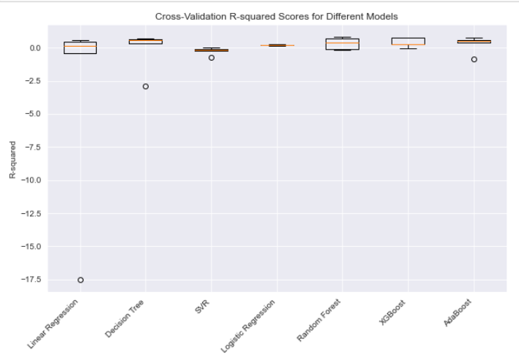
Cross Validation Comparison
Based on Cross Validation R*2 scores across models were plotted
SVR R*2 scores are lowest with outliers
More spread on validations on higher side for XGBoost and Random Forest,AdaBoost

Slide 9
Recommendations and Conclusion

